Slide 1
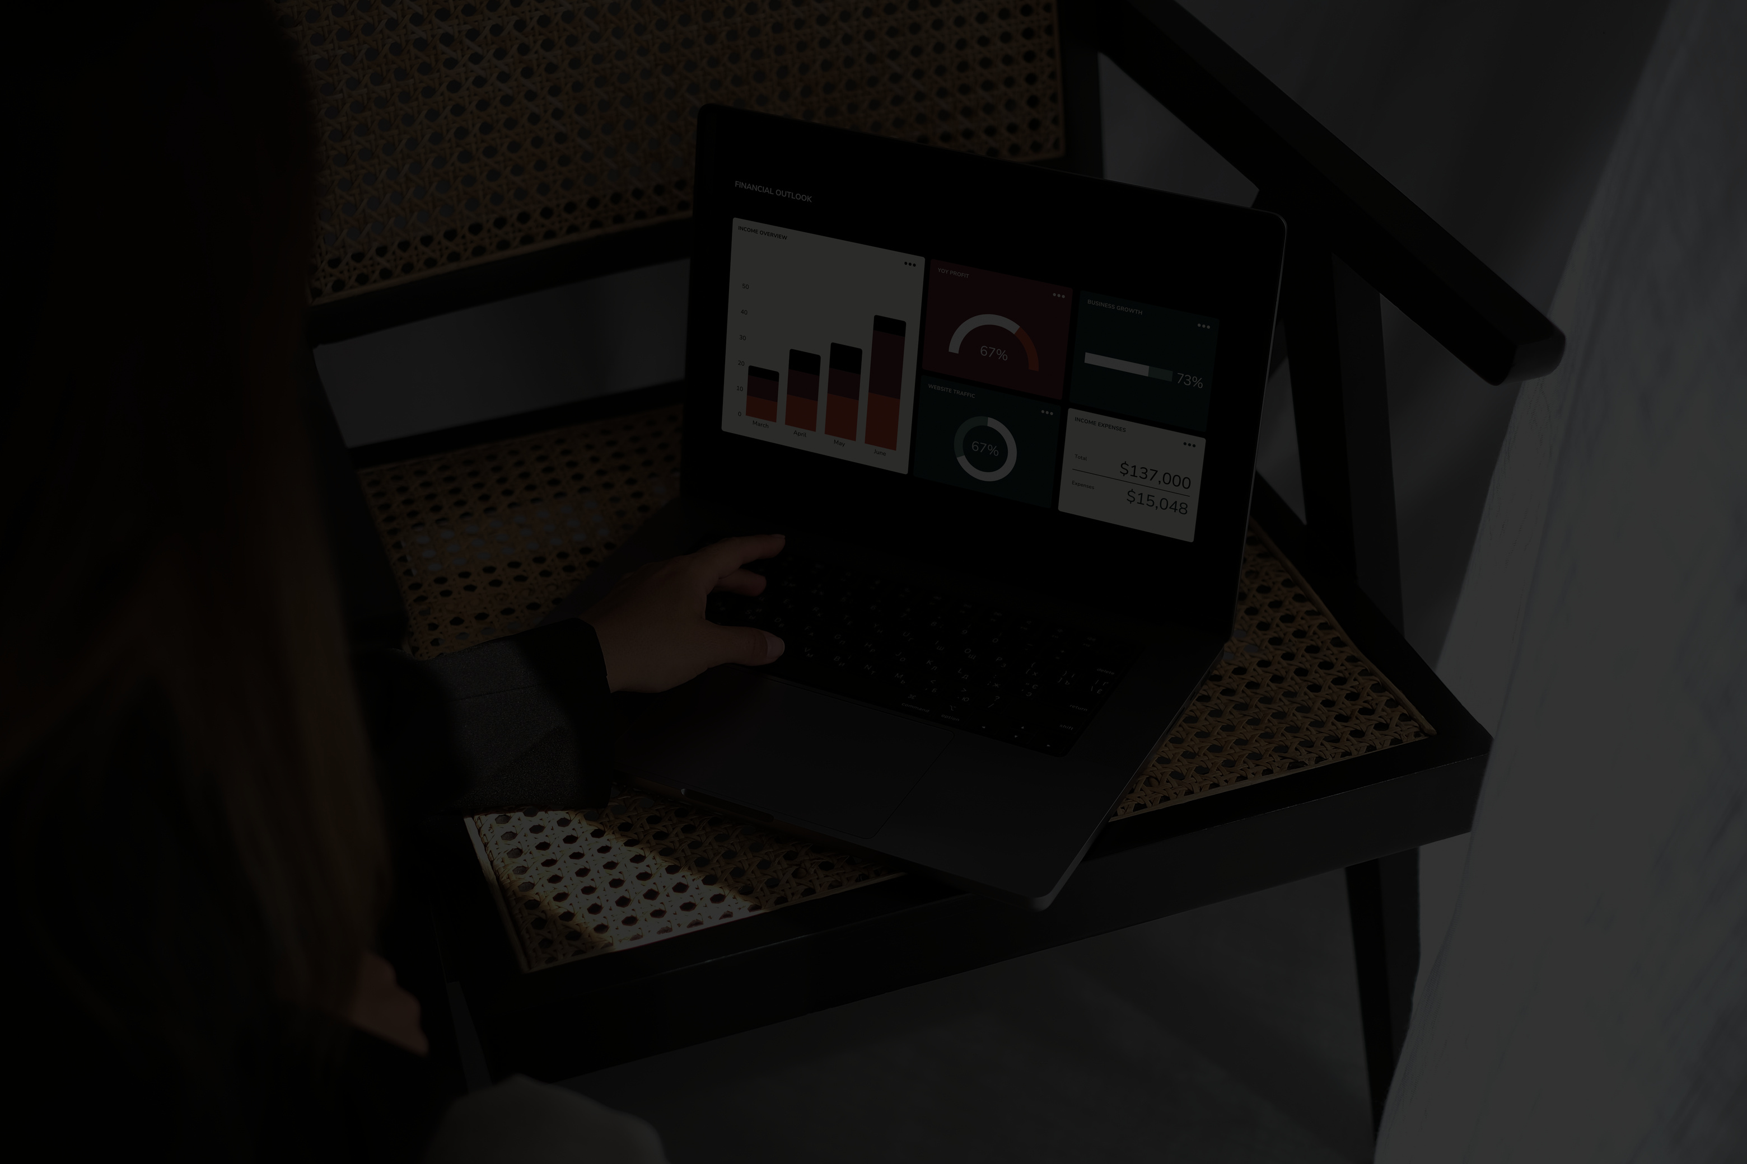
REXOS’S HOTEL CORP
DATA ANALYSIS
BY HASSAN GEBRILL

Slide 2
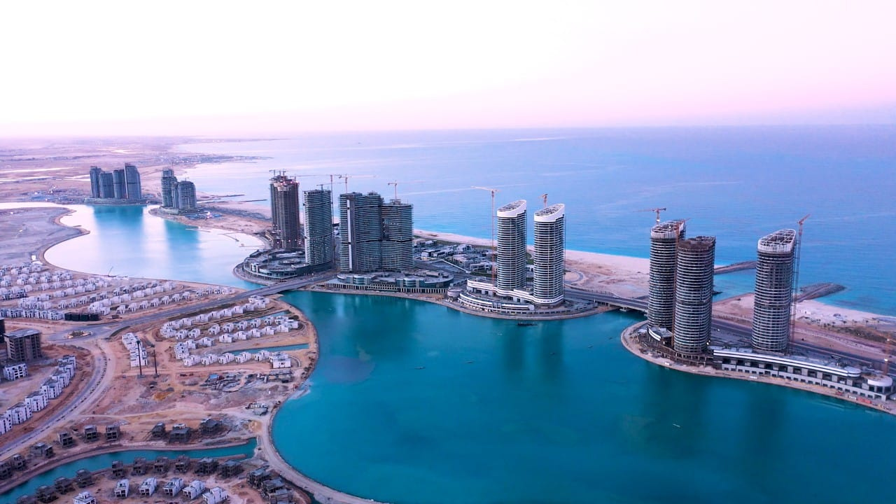
REXOS HOTEL
Dataset origins
and more information
I have acquired the data set from a hotel in new alamin,they’re facing a cancellation problem

Slide 3
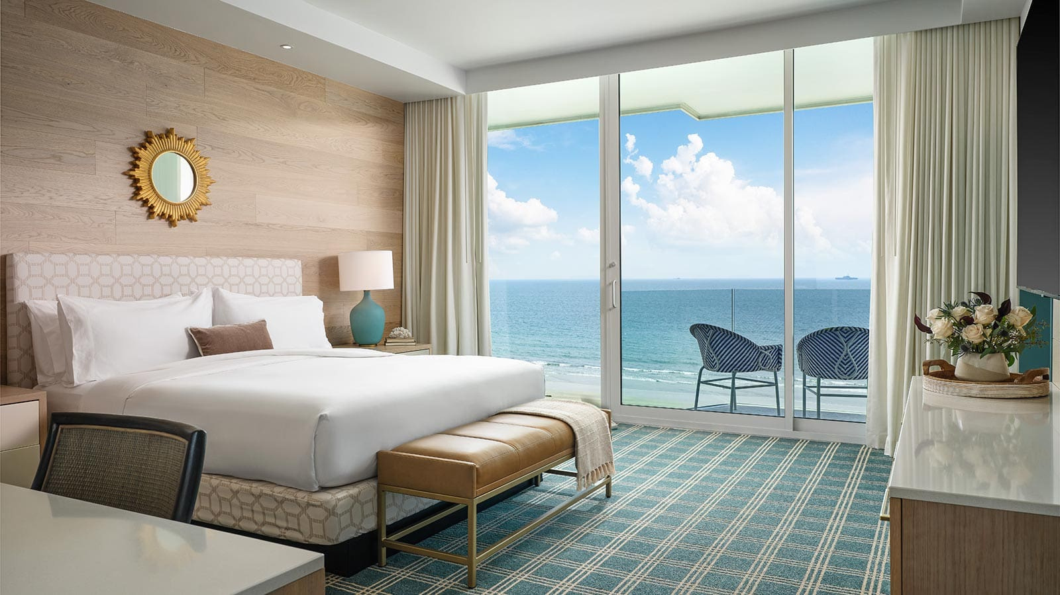
SALES LAST YEAR
REXOS HOTEL
24K
11K
NOT CANCELLED
CANCELLED
These are the number of customers that didn’t cancel
This is the number of customers that cancelled their room

Slide 4
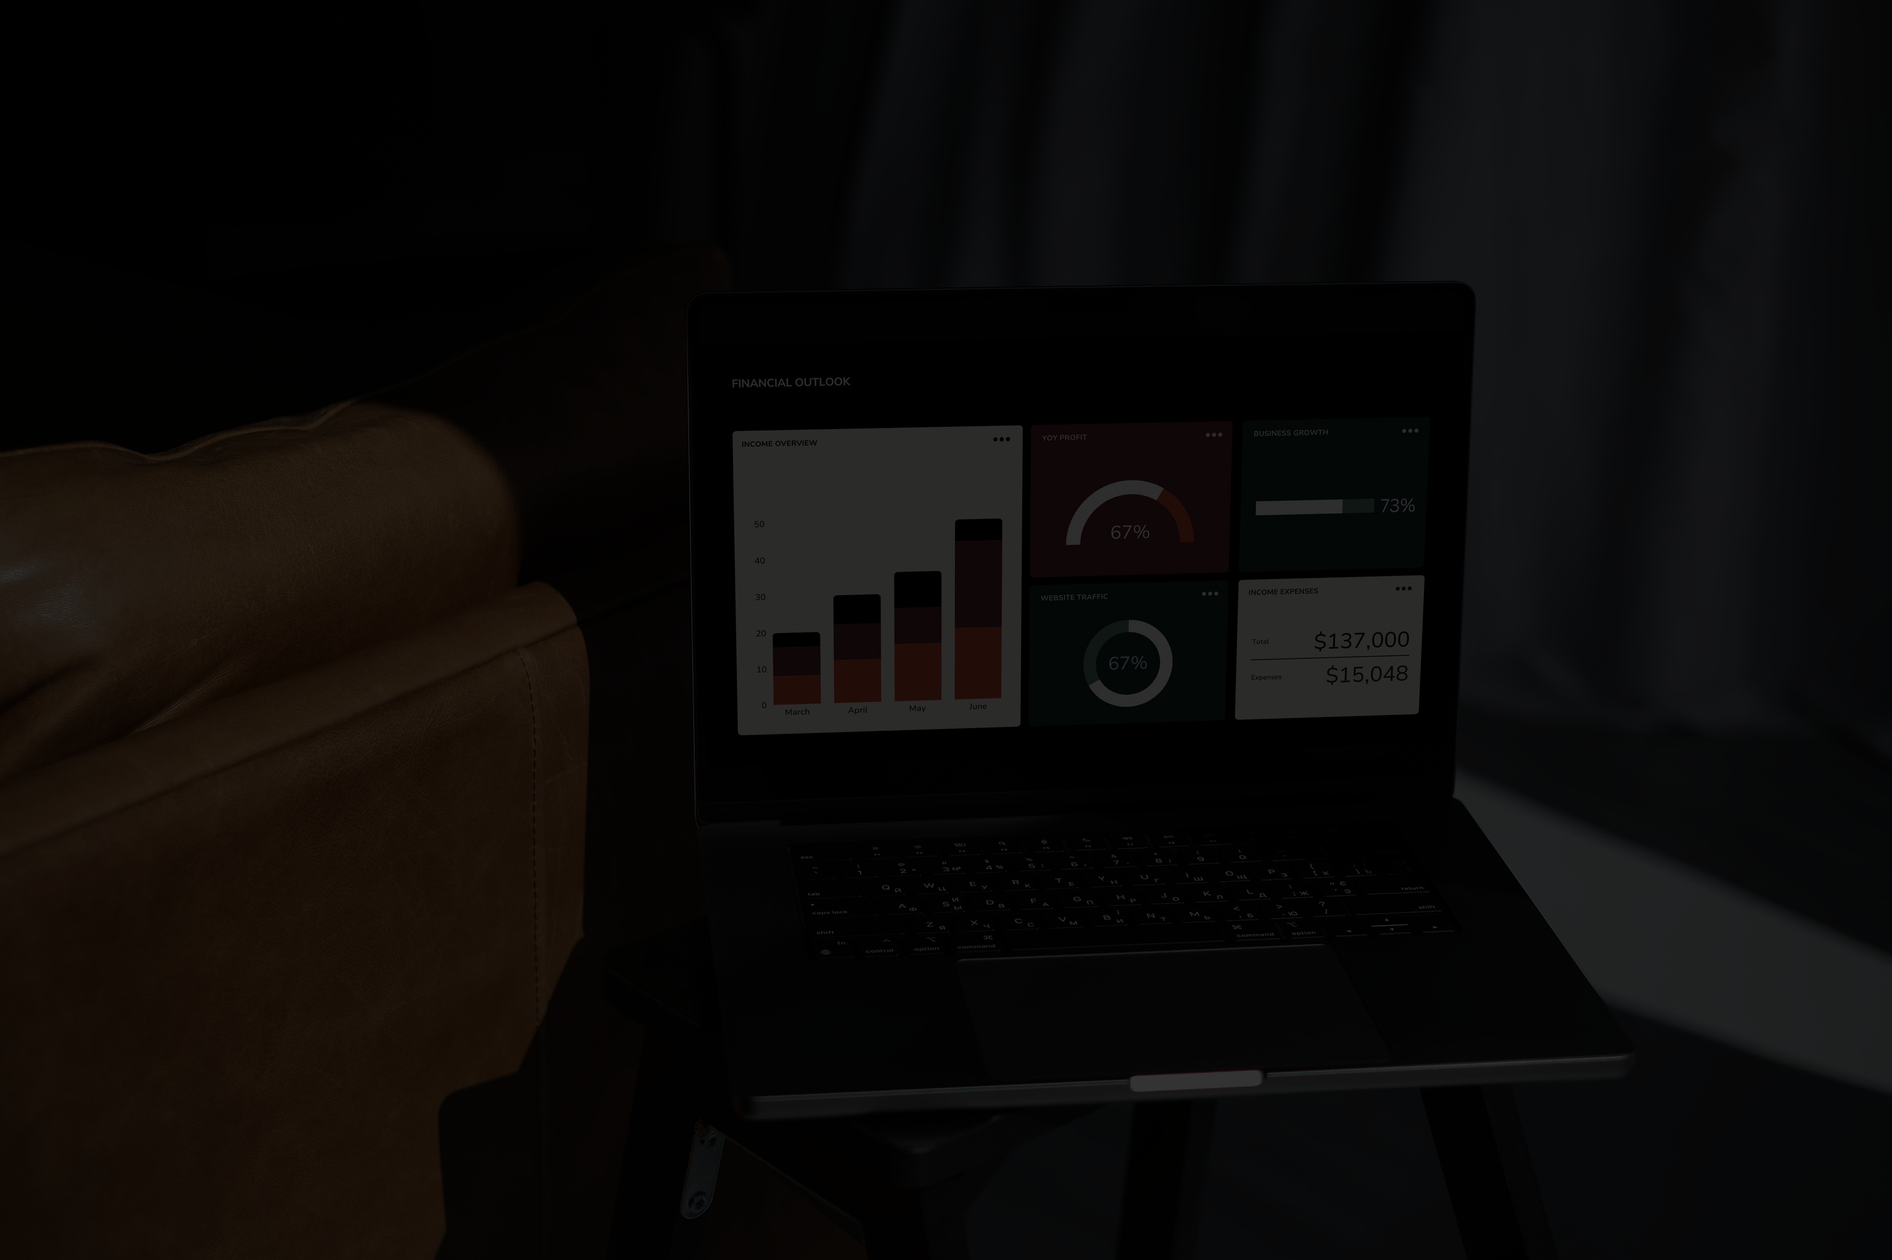
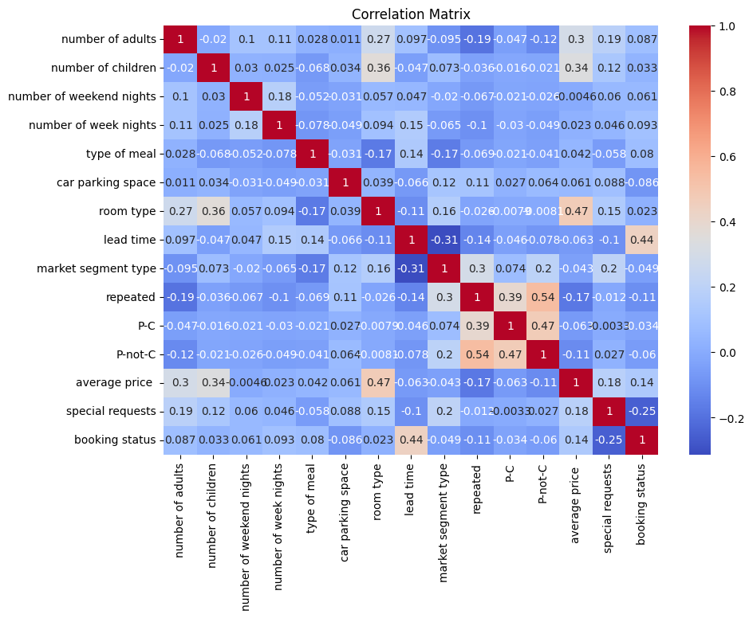
FIRST HEAT MAP
REXOS HOTEL
This is the first heatmap that shows all of the relations in the given dataset and from this heatmap I extracted the knowledge of the important columns:(P-C,P-not-C,Repeated,Cost and Room type)

Slide 5
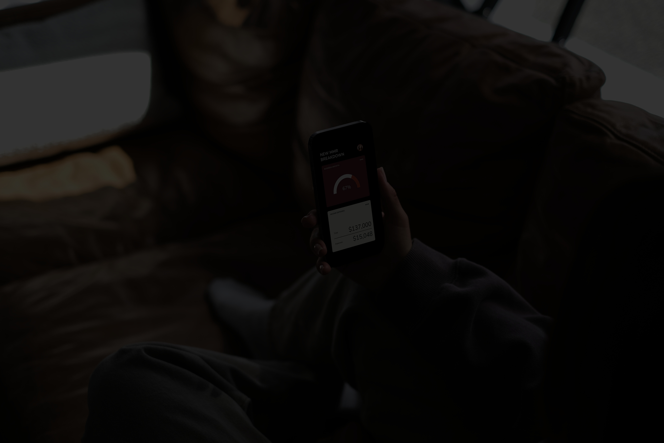
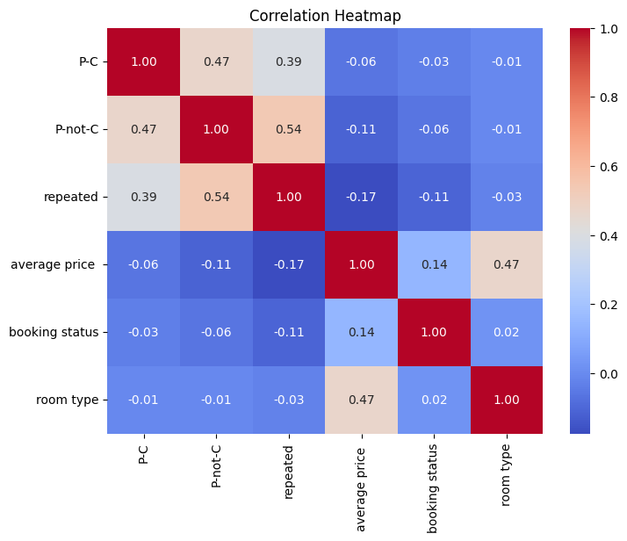
REXOS HOTEL
NEW HEATMAP
NEW INFORMATION:
Now that we have the data we need we can create a new heatmap using the important columns only and with the new heatmap we can deduce that:
Average price has the strongest correlation with cancellation
Repeated and P-not-C are negatively correlated
P-C has weak negative correlation with cancellation

Slide 6
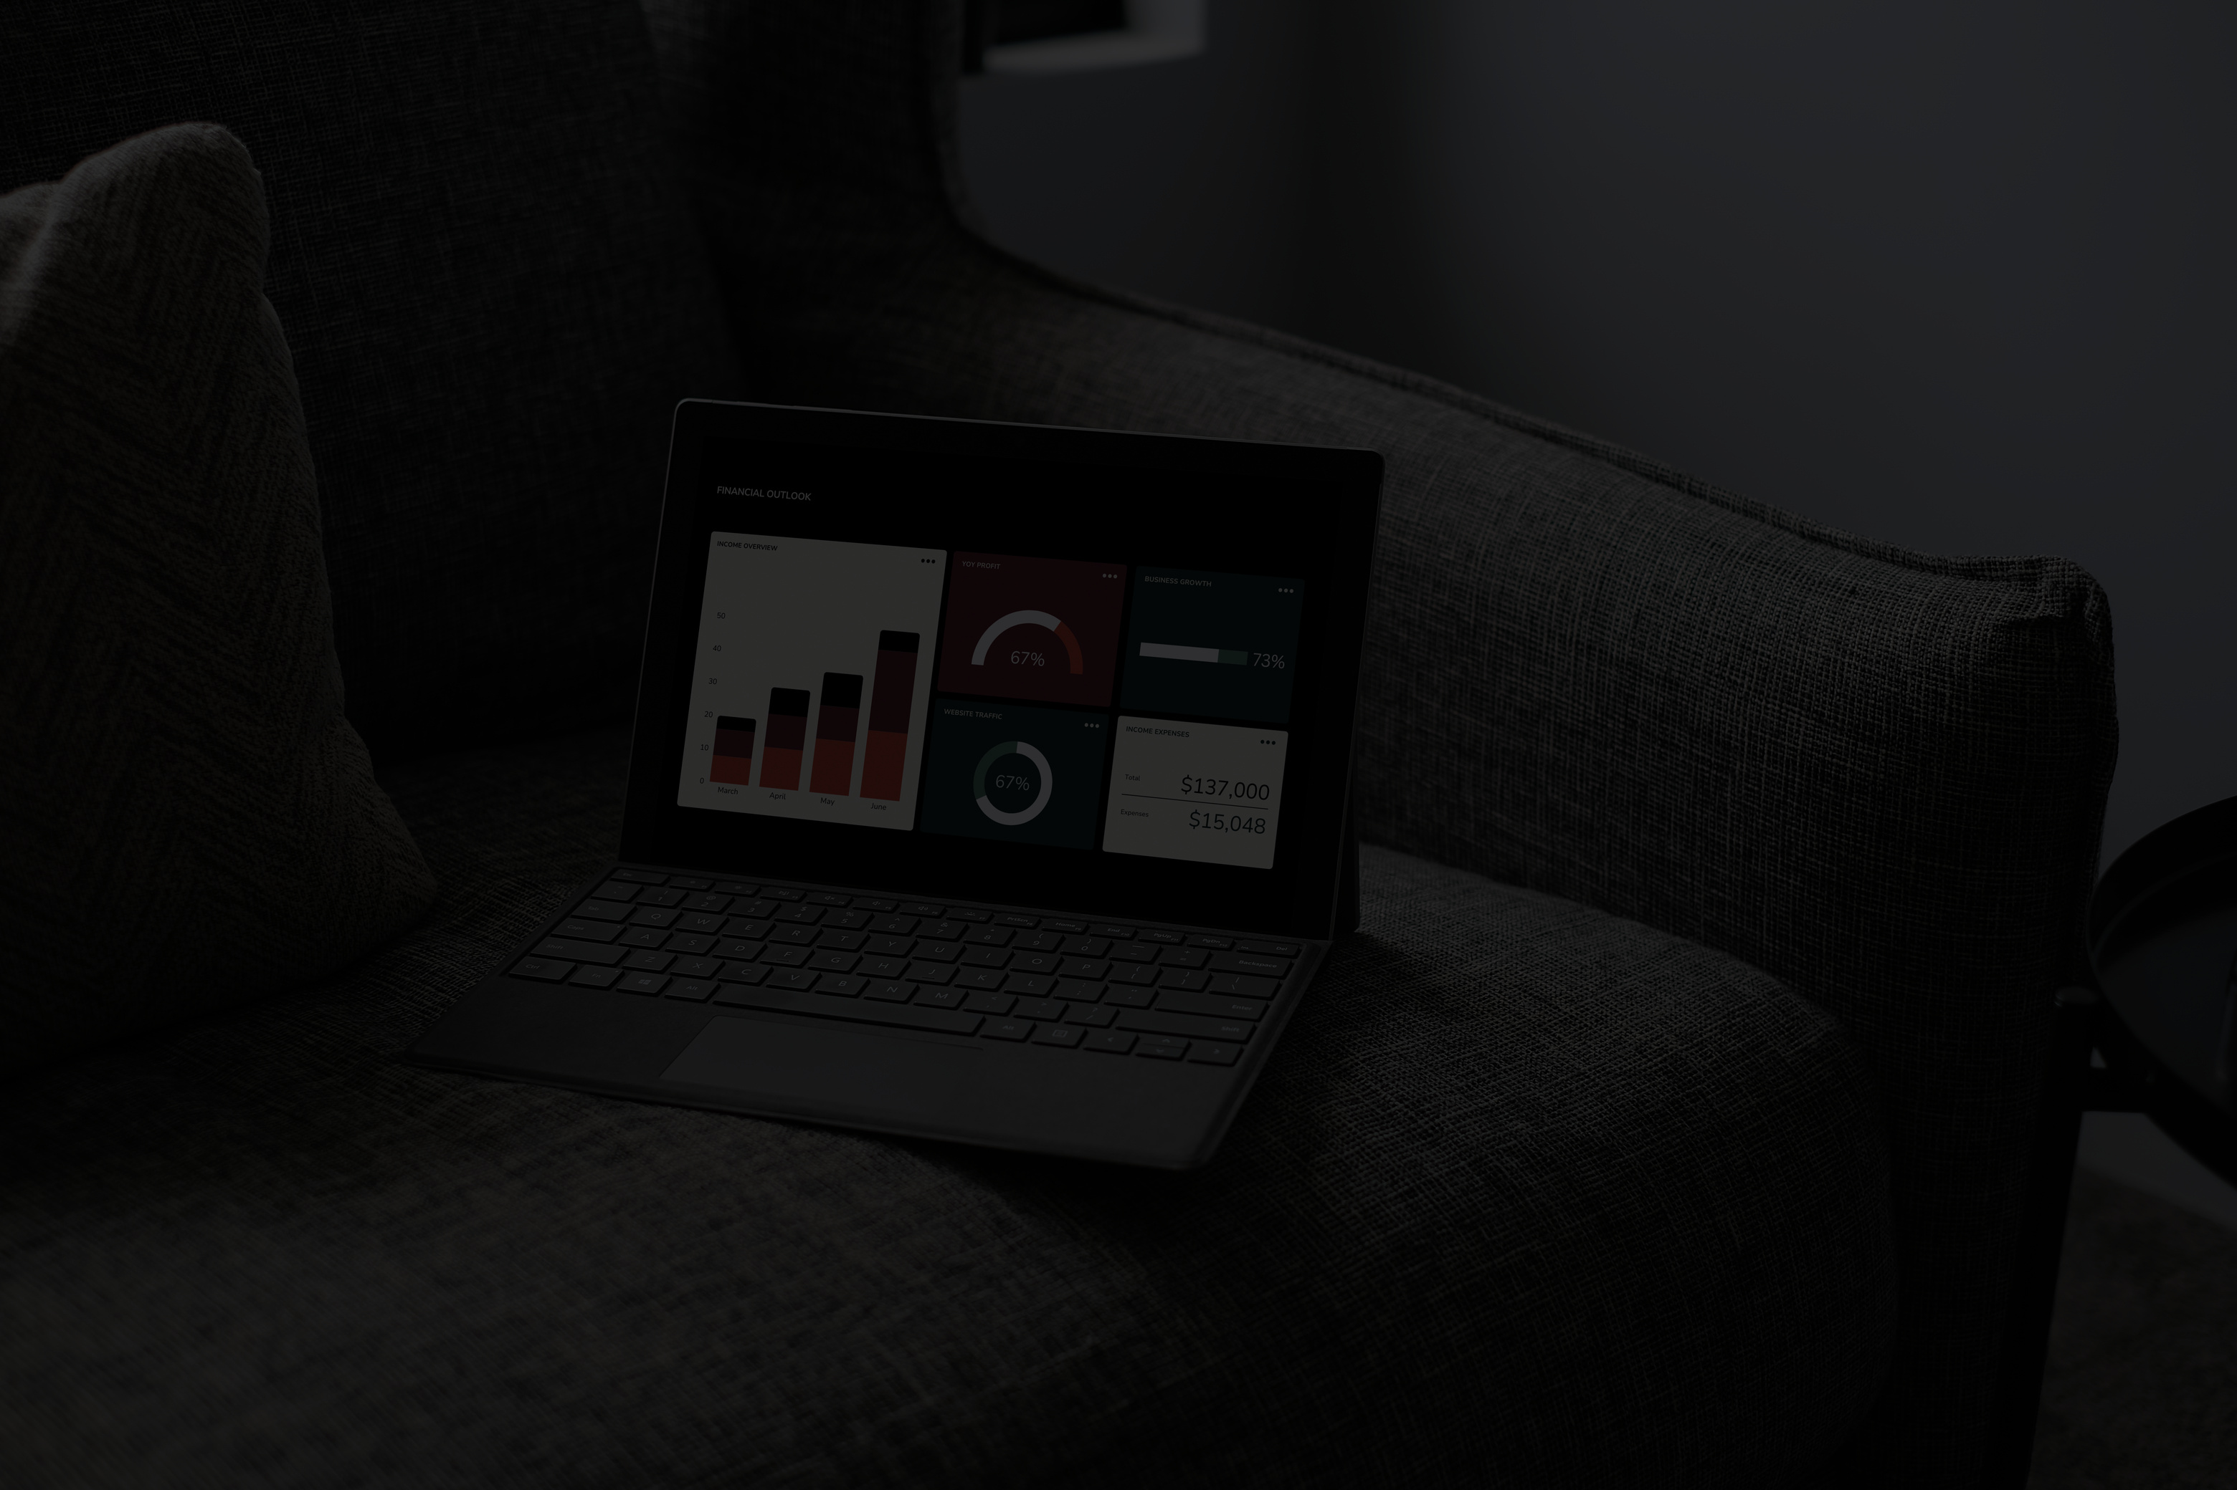
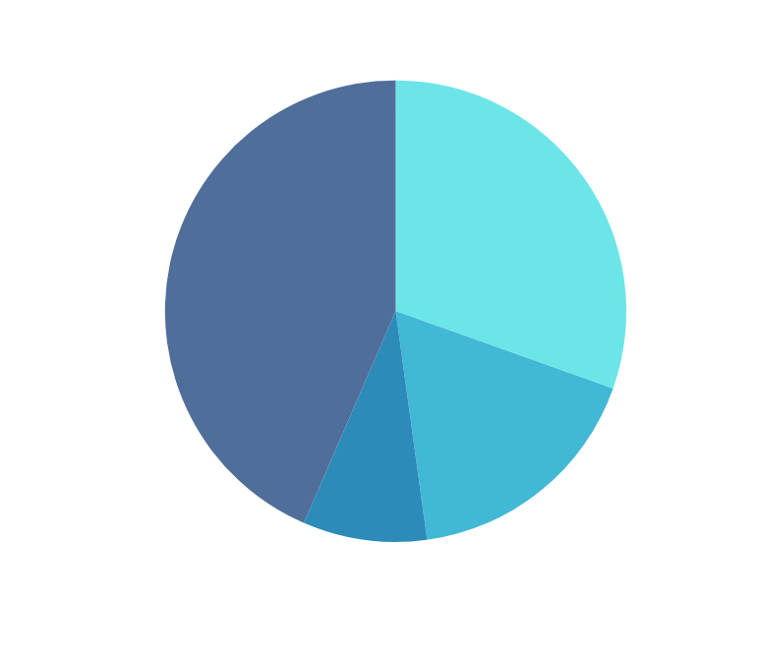
CANCELLED DATA
REXOS HOTEL
31,4%
HOW MANY HAVE CANCELLED
The number of people that cancelled and their reasons
Most customers cancel depending on room type , Cost or previous cancellation
We deduce that the strongest two factors are average price and room type

Slide 7
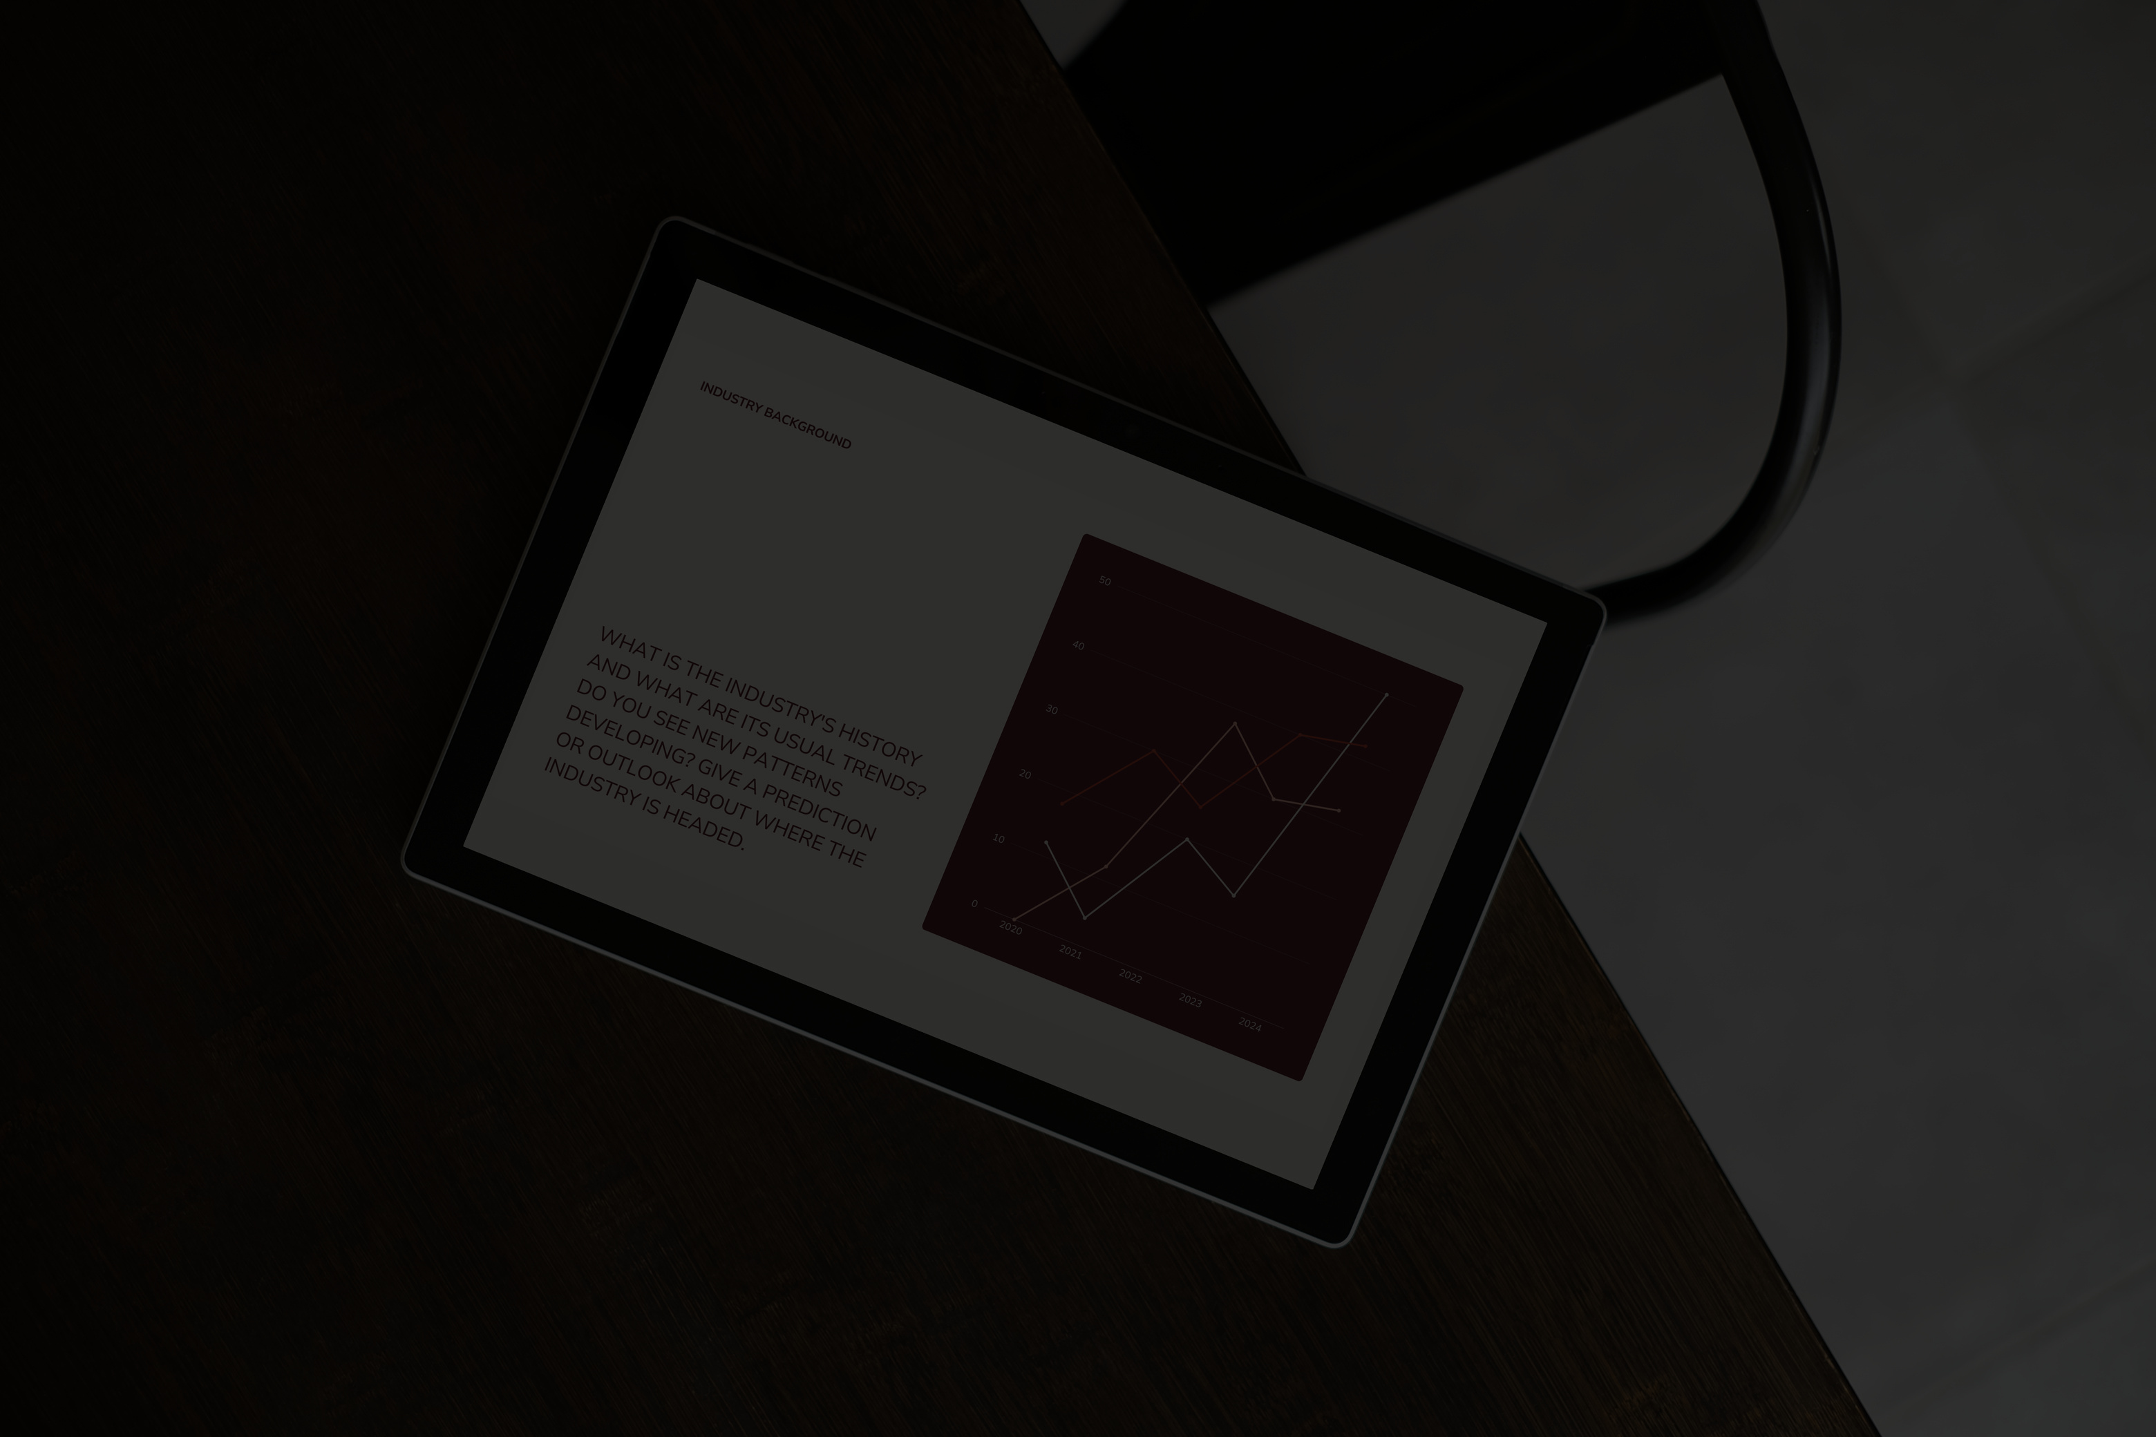
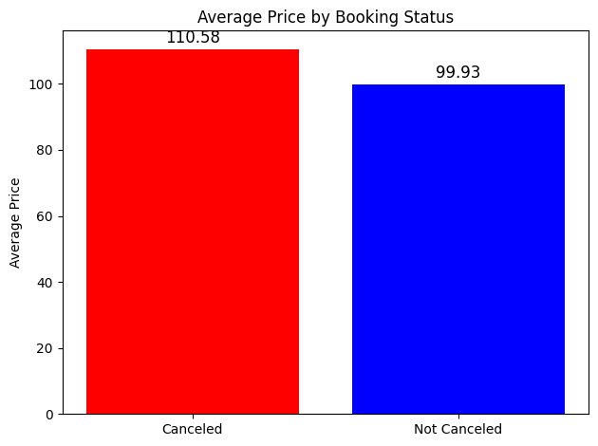
AVERAGE PRICE
REXOS HOTEL
AVERAGE PRICE CANCELLATION:
High prices have the highest rate of cancellation,
The higher the average price the less people will not cancel
110.58 VS 99.93:
When the average cost was 110.58$/Day it was very likely for customers to cancel
but when it was 99.93$/Day it was very unlikely for customers to cancel

Slide 8
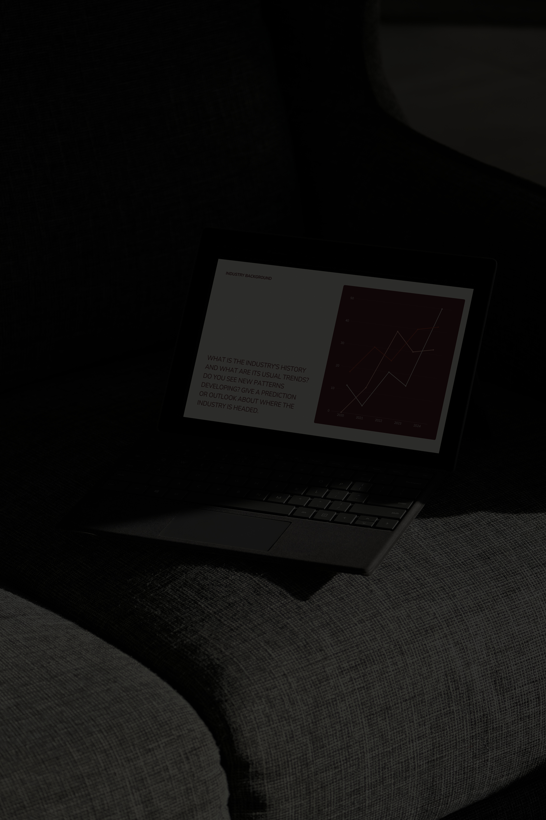
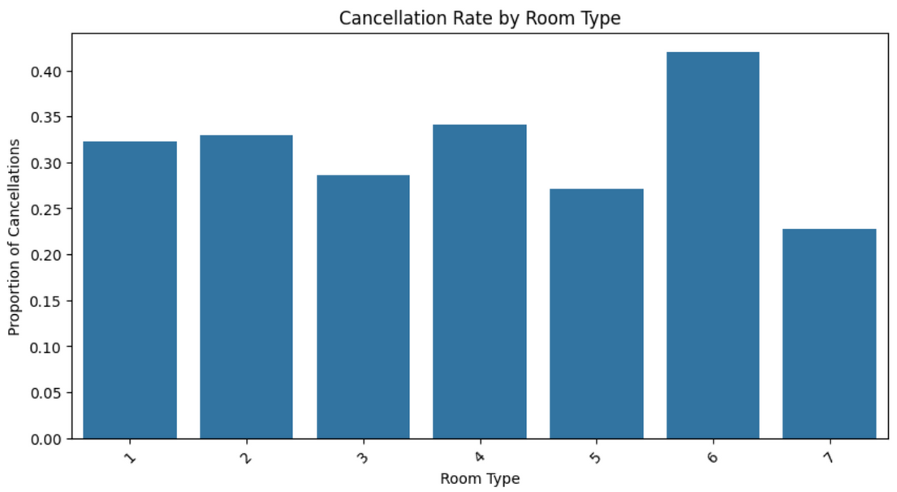
CANCELLATION BY ROOM TYPE
REXOS HOTEL
TOTAL ITEM SALES
Most people cancel due to room types
Room service
Room order
the room with most cancellation is type 6

Slide 9
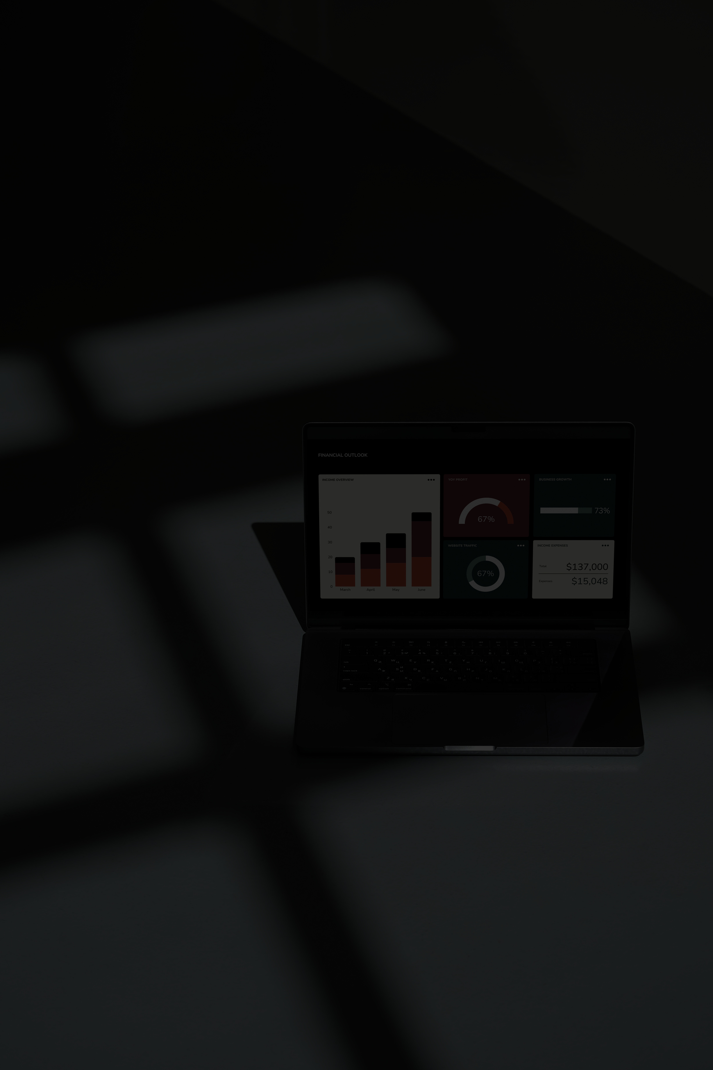
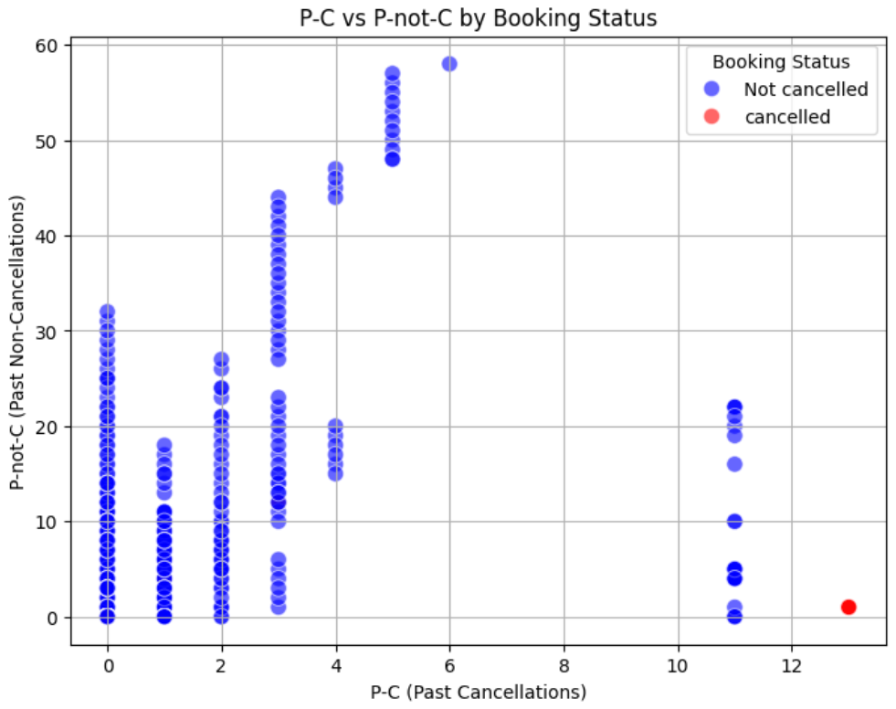
P-C AND P-NOT-C
REXOS HOTEL
0.7
PAST CANCELLATIONS
Most people who cancelled in the past don’t cancel again but it’s possible to find people who cancel
0.3
PAST NON CANCELLATION
People who didn’t cancel in the past have a very slim chance of cancelling

Slide 10
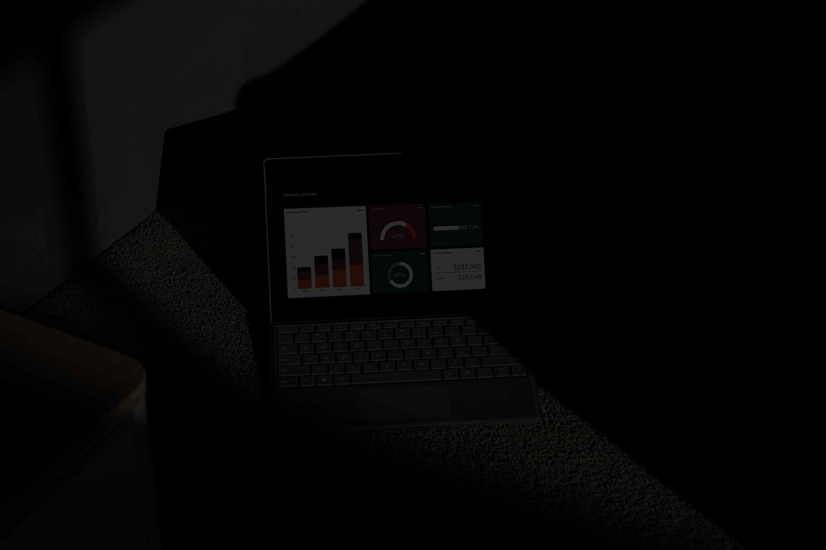
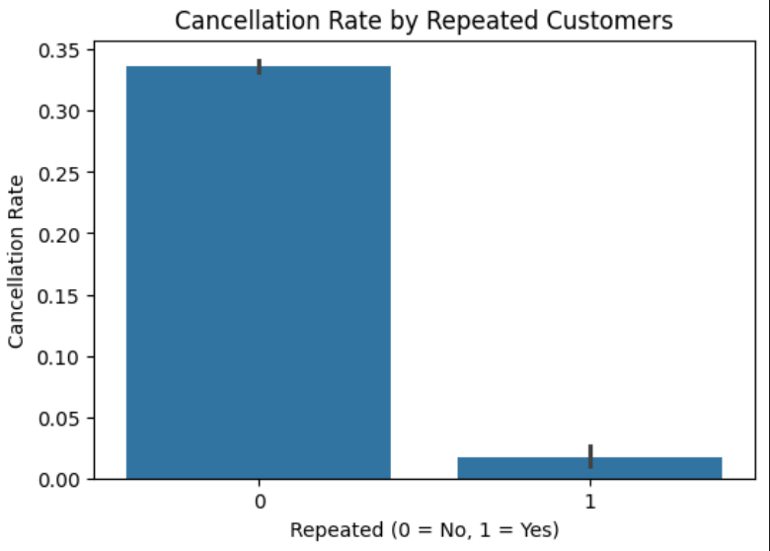
REPEATED
REXOS HOTEL
REPEATED
We learn that returning customers are more likely to not cancel as for the new customers.

Slide 11
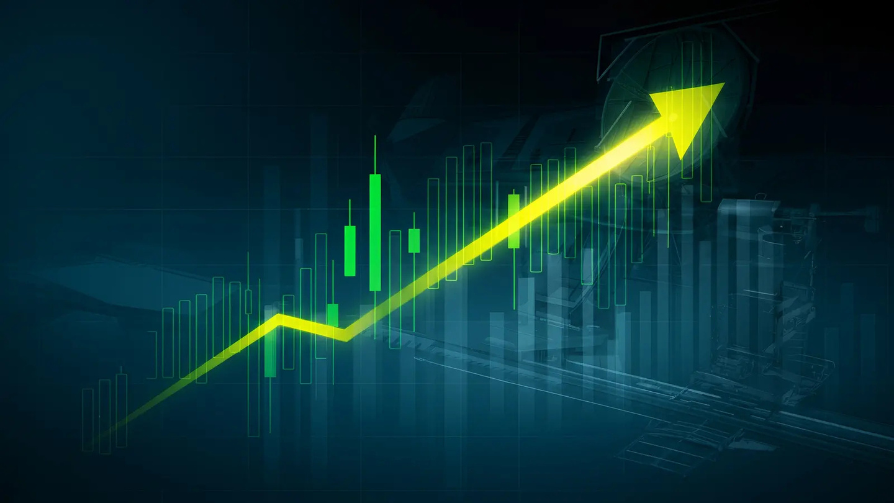
SUMMERY
REXOS HOTEL
In order for the hotel to thrive we have to
Keep the average cost at 99.1 or lower
Examine the problems with room type 6 and work on it
Encourage people with previous cancellation to give us a try
Depend on coming back customers to give us an honest review

Slide 12
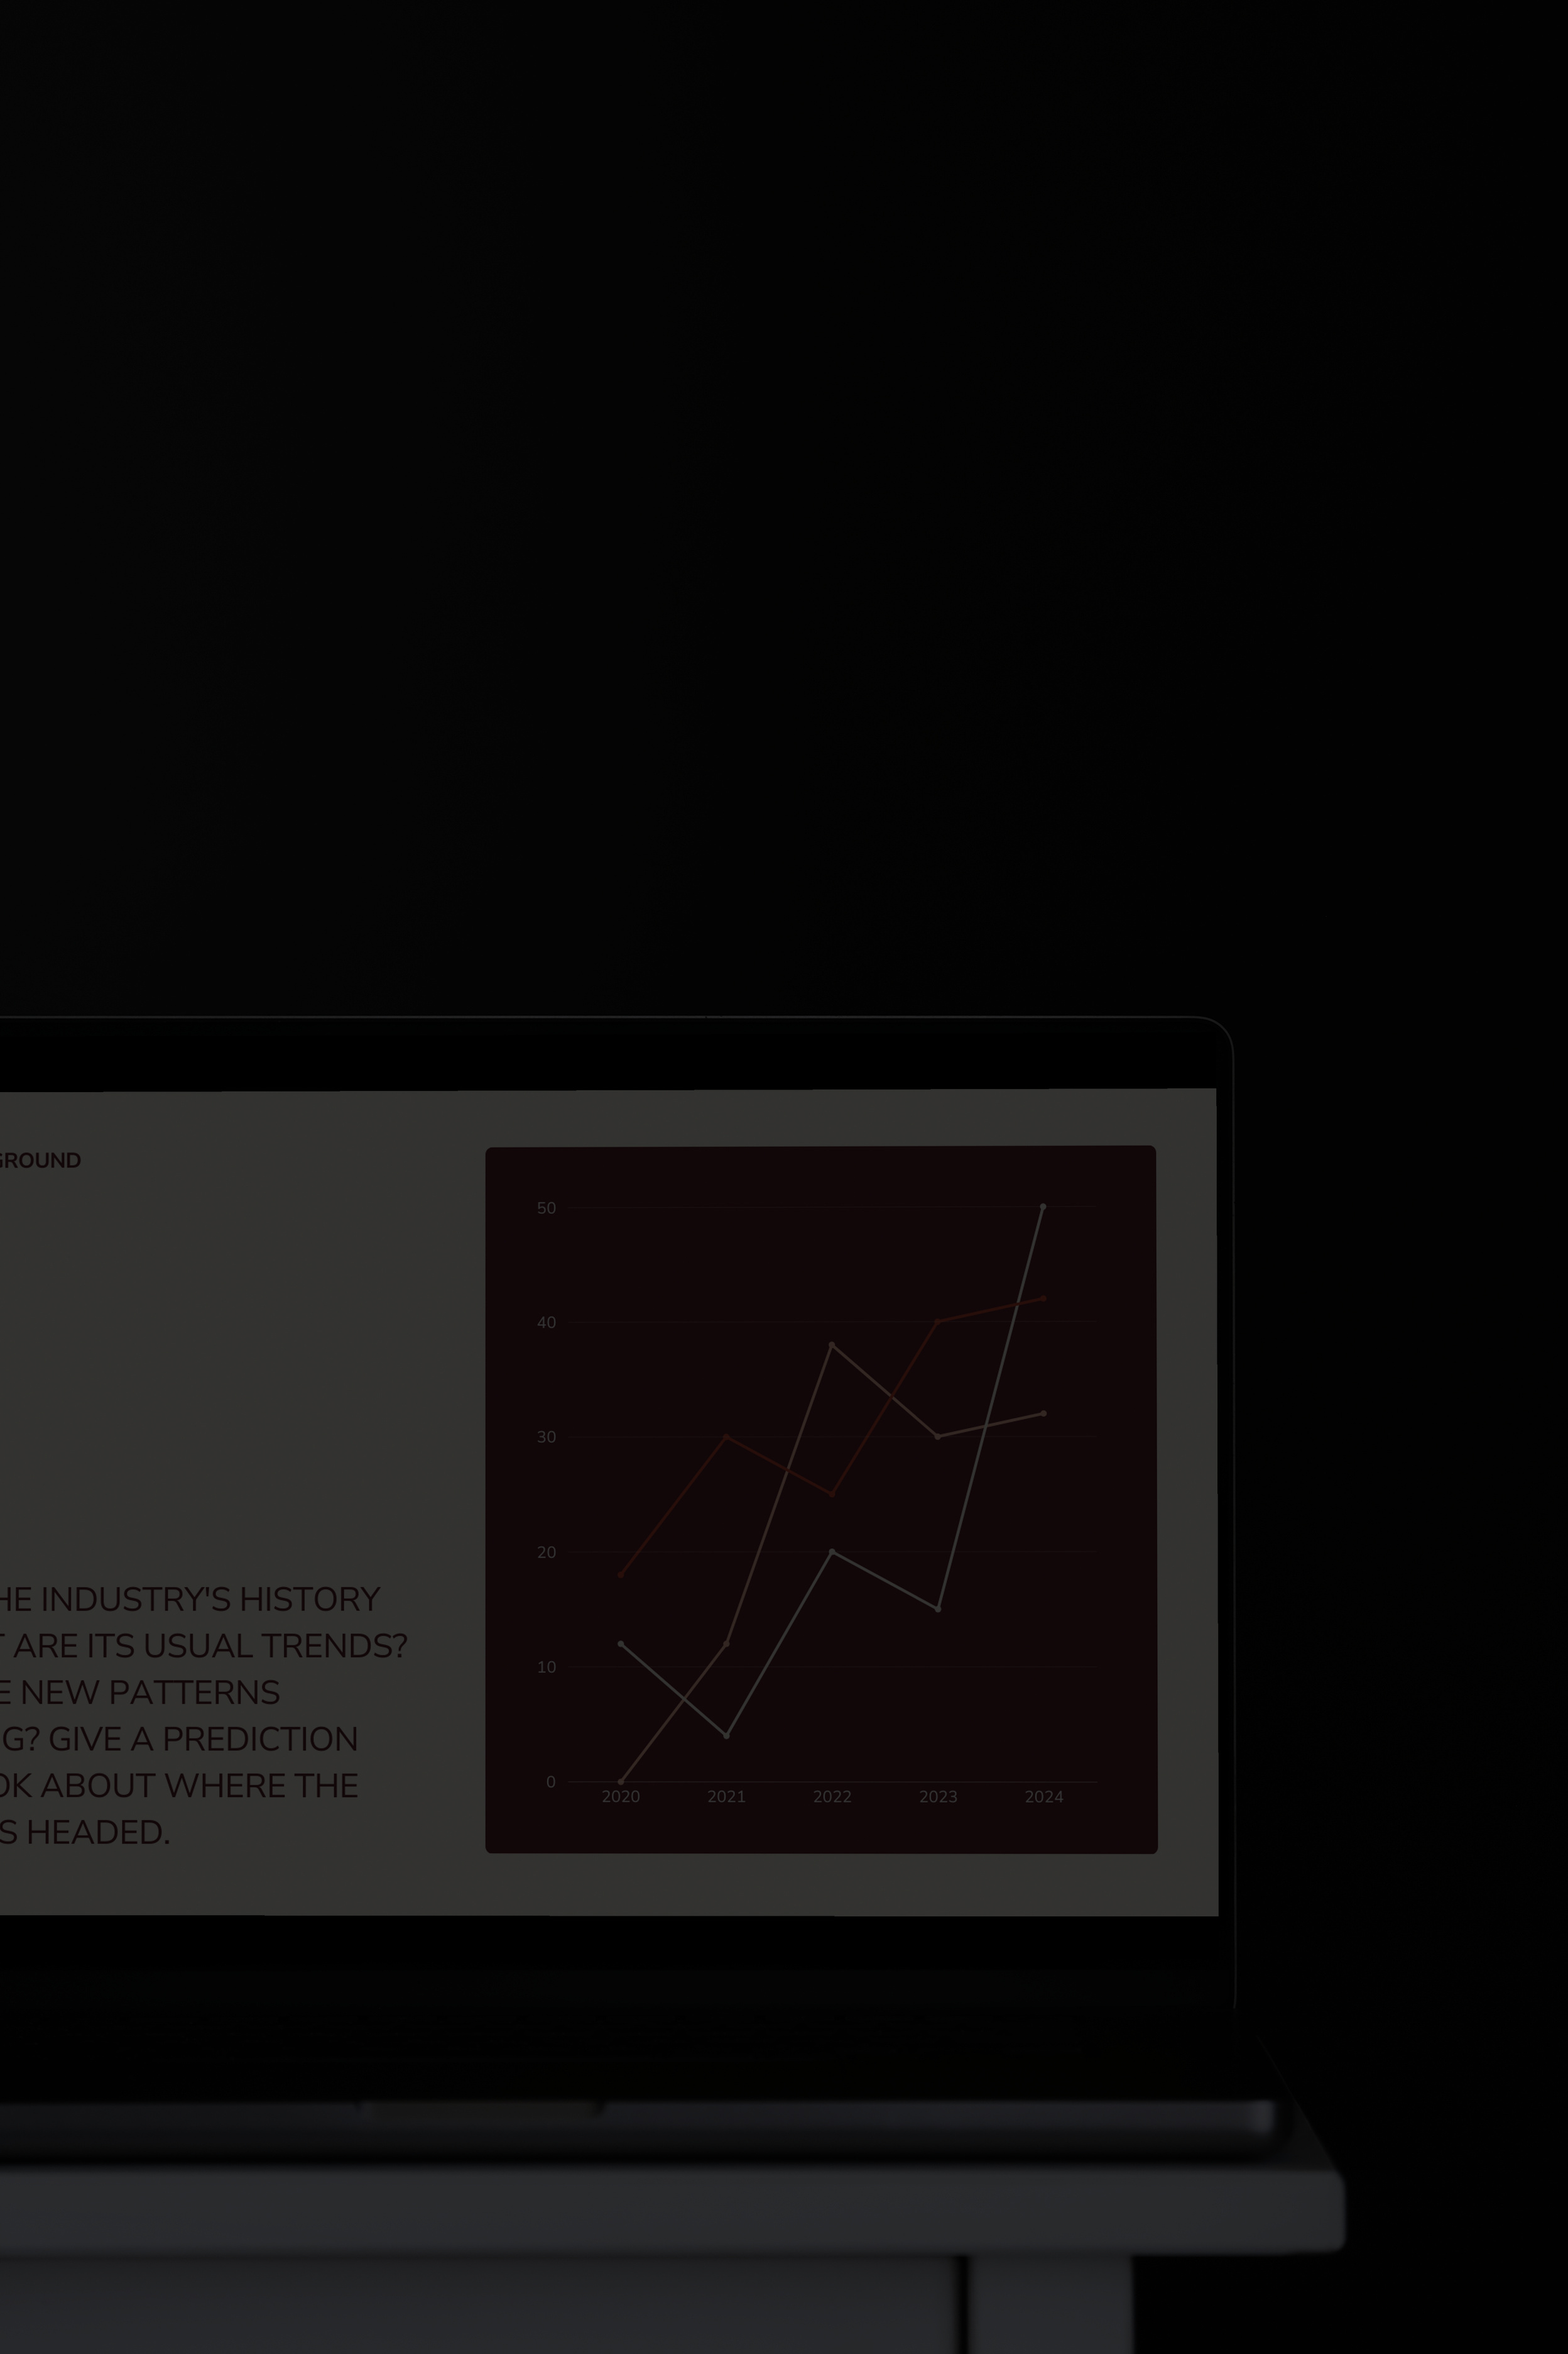
THANK YOU
ANY QUESTIONS?

